Slide 1
Bayesian Inference in Python
PyMC3 vs PyStan

Slide 2
Bayesian Inference in Python PyMC3 vs PyStan
Nuo Xu
Daniel Eriksson
PyCon Sweden 2017, Stockholm
Email: xu_nuo77@hotmail.com
Github: stay tuned
Notes:
Good morning everyone. My name is Nuo, I work with credit risk in a bank here in Stockholm. Today I’ll talk about how Bayes models are implemented in Python, PyMC3 and PyStan and compare those 2 Bayes packages.
In recent years, Bayesian modeling has improved dramatically with the application of Hamiltonian Monte Carlo and specifically the No U-turn sampler (NUTS).
Now is a great time to use Bayesian models, because we finally have algorithms powerful enough to leverage these complicated models.
This talk is aiming to inspire data scientists who want to add another tool to their toolbox, to those who have data and want to extract knowledge using Bayesian techniques.
As you might know, there are 2 excellent packages in Python when it comes to Baysian Inference, PyMC3 and PyStan.
When there is only one package, you don’t have many choices. But now we have 2, which one should I choose? It’s like buying shoes, or worse than buying shoes. Shoes you can buy both, but for implement the model, you don’t really need to do on both packages.
I hope after this talk, you will have ideas about where to implement your Bayesian models.
Before we go to the next slide, I would like to say many thanks to Daniel. I really appriciate all the support from him. By the way, he is my husband.

Slide 3
Assumed knowledge
Familiar with Python
Basic knowledge in statics and probability theory
Notes:
In order to enjoy this talk, I would expect you to be familiar with Python. You have been programming in Python and used at least one package.
When it comes to the theorical part, it is on entry level. The aim here is not to talke about Bayes, but to implement Bayes Models in PyMC3 and PyStan and compare those 2 packages.

Slide 4
Outline
Basic Bayes concepts (Bayes rule -> Bayes Inference)
A generated model in PyMC3 and PyStan
A more practical model in PyMC3 and PyStan
Summary
Reference
Q & A
Notes:
First, I’ll refresh our memory about basic Bayes concepts. I’ll talk about about Bayes rules and how it becomes Bayes Inference quickly.
Second, I’ll introduce a generated model in both PyMC3 and PyStan
And then, I’ll introduce a more complicated model, more parameters. I’ll use the data from allsvanskan, to predict who has the highest probability to win, to qualify and to be relegated.
I also have summary, some reference that you can read or watch and a Q & A session in the end.

Slide 5

Basic Bayes Concepts
The classic Bayes’ rule
$P\left(A | B\right)= \frac{P(B|A)P(A)}{P(B)}$
Bayes Inference
$p\left(θ | y\right)=\frac{p\left(y | θ\right)p(θ)}{\int{p\left(y | θ\right)p\left(θ\right)ⅆθ}} ∝p\left(y | θ\right)p(θ)$
likelihood
prior
posterior
Notes:
Classic Bayes Rule: Does it look familiar to you? The Bayes rule is a result in probability theory. But together with the notion of prior (personal probabilities) and the likelihood, Bayes rule provides the basis for Bayesian inference.
This is a prior, this is a likelihood and this is the posterior. denomitor is a scaling factor, we don’t have to care about it here. We say that the posterior distribution is proportional to likelihood times prior. The posterior is what I am interested in. I observed some data, the distribution of the parameter is what I am interested in.
The denomiter is also called marginal likelihood, it provides information about the support in the data for the prior beliefs and the likelihood. It is just the probability of the data. It is used in Bayesian hypothesis testing. But here it is just a scaling factor, we don’t have to care about it.
So, by using Bayeian model, we add our personal or expert knowledge to the model as our prior. We also quantify the uncertainty of the parameter. Here, theta, our parameter is no longer a fixed value, it has it’s own distribution.
Sometimes or most of the time, it’s difficult or impossible to compute the posterior. Posteriors are complicated. Then you need good sampling algorithmes to understand the posterior. That’s why we need PyMC3 and PyStan. Both of them have the state-of-the-art sampling algorithems and they will do the inference for us. For example, if you have a die and you don’t understand how it works. Then you roll it and write down what you have. Most of the cases, the posterior are very complicated. That’s impossible to do with pen and paper. But don’t worry, PyStan and PyMC3 will do the inference for you.
=========================================================
P(y|theta) can have 2 meanings, 1 sampling, 2 likelihood. When we talk about sampling, it means given theta fixed, the distribution of y, or the function of y. It can be probability distribution. The likelihood, is the theta, given y fixed. This is not a probability function.
Let’s compare Bayes rule and Frequentists with an example: the “fair coin”. Imagine I flip a coin 20 times, 15 times head. as a frequentist, I can the probability of getting head is 15/20. and I also want to construct confidence interval, Null hypothesis is: the coin is fair, if we write it in a statistics way: Prob(H) = 0.5, easier to understand, right? The alternative hypothesis is ….. And I want P-value: probability of the observed values or extreme ones under the null hypothesis. …….(write more!) Whil in a Bayes world, I still want to know if the coin is fair or not, coins are usually fair, right. The toss the coin experiment can be models as a a Binomial trial, with parameter p. I believe coins are usually fair, and maybe one side can werm out a little bit more than the other side. So I give a normal(0.5, 1) as my prior.

Slide 6
A generated model in PyMC3 and PyStan
Generate 50 samples from N(0,1)
Study the sample -> inference, mean
Notes:
Now I’ll introduce the first model, a generated model in PyStan and PyMC3.
I generated 50 random samples from a standard normal distribution.
We have the data and pretend we don’t know how the data is generated and we want to study the samples and do inference.
In this case, we want to know the true population mean.
We look at the data, x, looks okay normal. I give the likelihood a normal distribution, the prior for the mean follows a quite strong prior, with mu = 0 and sd = 0.5.
Just to simplefy this example, I just give 1 to the sd in our model.
Below is the core part of using PyMC3 and PyStan.

Slide 7
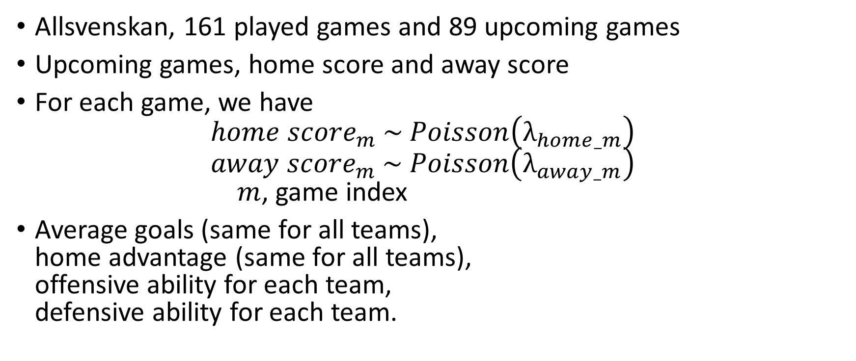
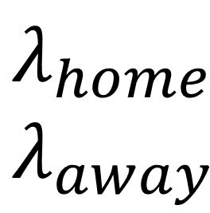
A more practical model in PyMC3 and PyStan
Allsvenskan, 161 played games and 89 upcoming games
Upcoming games, home score and away score
For each game, we have ${home score}_{m} \sim Poisson\left(λ_{home_m}\right)$ ${away score}_{m} \sim Poisson\left(λ_{away_m}\right)$ $m$, game index
Average goals (same for all teams), home advantage (same for all teams), offensive ability for each team, defensive ability for each team.
$$λ_{home}$$
$$λ_{away}$$
Notes:
Now I am going to talk about the implementation in PyMC3 and PyStan with a more practical example.
Imagine I am a big fan of football, I want to know who has the highest probability to win, to qualify and to be relegated in allsvenskan.
The data looks like this. Left is the played games, right is the upcoming games. 161 played games and 87 upcoming games back then.
Each game has a home team, away team, home score for home team, and away score for away team.
In the upcoming games, I know the home team and away team, but I don’t know the scores. The home score and away score for each game is what I am interested in.
For each match, the score for home team and away team follows Possion distribution. Home team has it’s own lamda and away team also has it’s own lambda.
So we have 16 home lambda and 16 away lambda. For example, Malmö can play as home team and away team, the rate to score is different when it plays as home team or away team.
The next question is to construct lambda. I choose average goals, home advantage, offensive ability and defensive ability to construct lambda.

Slide 8
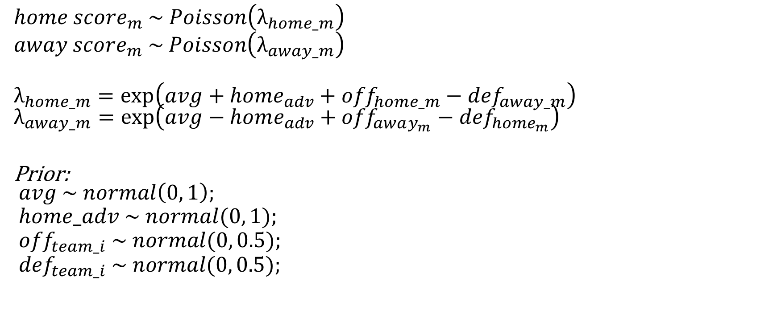
A more practical model in PyMC3 and PyStan
$${home score}_{m} \sim Poisson\left(λ_{home_m}\right)$$
$${away score}_{m} \sim Poisson\left(λ_{away_m}\right)$$
$$λ_{home_m}=\exp\left(avg+home_{adv}+{off}_{home_m}−{def}_{away_m}\right) \\ λ_{away_m}=\exp\left(avg−home_{adv}+{off}_{away_{m}}−{def}_{home_{m}}\right)$$
Prior: $$avg \sim normal\left(0, 1\right);$$
$$home_adv \sim normal(0, 1); \\ {off}_{team_i} \sim normal(0, 0.5); \\ {def}_{team_i} \sim normal(0, 0.5);$$
Notes:
Remember that lambda has to be grater than zero. So I exponential of (average goals, home advantage, offensive ability and defensive ability)
For example, if I am Malmö and playing with you guys Djugården at home. ….
Next time, you guys play at home. My lambda will be my away lambda
My priors are avg goals, home adv, those 2 are the same for all teams. Offensive and defensive ability for each team.
Let go back to Python.
Show the table, preparing the data
Model block
Run the sampling
Prediction
Following work is done in Python, calculated the points, goals for and goals against and the final probability to win, qualify and to be relegated.

Slide 9
A more practical model in PyMC3 and PyStan
Notes:
Posterior checks
Posterior predictive checks are, in simple words, "simulating replicated data under the fitted model and then comparing these to the observed data" (Gelman and Hill, 2007, p. 158). So, you use posterior predictive to "look for systematic discrepancies between real and simulated data" (Gelman et al. 2004, p. 169).
The argument about "using the data twice" is that you use your data for estimating the model and then, for checking if the model fits the data, while generally it is a bad idea and it would be better to validate your model on external data, that was not used for estimation.
Posterior predictive checks are helpful in assessing if your model gives you "valid" predictions about the reality - do they fit the observed data or not. It is a helpful phase of model building and checking. It does not give you a definite answer on if your model is "ok" or if it is "better" then other model, however, it can help you to check if your model makes sens.
Comparing the predictive distribution yrep to the observed data yis generally termed a "posterior predictive check". This type of check includes the uncertainty associated with the estimated parameters of the model, unlike frequentist statistics.
Gelman recommends at the most basic level to compare yrep
to y, looking for any systematic differences, which could indicate potential failings of the model (Gelman et al. 2004, p. 159). It is often first recommended to compare graphical plots, such as the distribution of y and yrep.

Slide 10
Summary
PyMC3 (Theano), PyStan (Stan)
Language PyMC3 -> Python, Stan -> C++ Stan can also be used in other environments, PyMC3 -> only Python Stan -> Statistics language
Dynamic model
Community
Performance
Packages only to assist, build the model and explain the model is what we should focus on.
Notes:
1. PyMC3 relies on Theano, While PyStan is an interface of Stan.
2. From the language perspective, PyMC3 is fully written in Python, while PyStan is a Python interface of Stan, which is written in C++. Stan can also be used in other languages, for example, R. PyMC3 is only a Python package. If you’ve never used R and C++ before, PyStan code could look a bit overwhelming for you. There are more code to write in the model block. On the other hand, PyStan is a more appropriate statistics language than PyMC3. It is easy understand the model when I have appropriate statistics language.
3. Sometimes you also want to build dynamic models. It is easy to build dynamic models in pymc3, but not as easy in pystan. The model part in PyStan is a string, so if you want to change something in the model, you can use string operator in Python. While PyMC3, everything is in Python. So you can just write normal Python code.
4. community. You can find modelling cases or examples in both communities. In PyMC3 you can directly find them on the PyMC3 doc. Pystan is not python focused. It comes from Stan, as I mentioned before. You need to go to Stan and find the cases. Those cases are not always written in Python and bit mathematically heavier than PyMC3 examples.
Stan also has an around 600 pages user’s manual, it is comprehensive and very well-written, there you can find all kinds of information about Stan, for example, the language, distributions and etc. For me, PyMC3 Docs is more like an IKEA instruction book. Simple and I can just use it.
5. Performance: When it comes to performance, we saw from the first examples, PyMC3 took less time to compile the model, but a bit longer time to do the inference. But there is no huge difference, it’s just about 2 minutes or 3 minutes. If you still remember the second allsvenskan model. A more complicated model and more samples to drawn. PyMC3 took less than one minute to compile the model, PyStan took like 3 minutes. But in the sampleing stage, there is a huge difference. PyStan took only like 3 minutes, while PyMC3 took half an hour.
6. All in all, packages just assist us to explore the data or the areas that we are interested in. What we have to work with is to build the model and to explain the model. Both of them have state-of-the-art sampling strategies you need. People are different, I can’t just say this is better than that. But I hope now, you have ideas about how and where to implement your models, your Bayes Models, I mean.
=============================================================
You need a C++ compiler in order to run PyStan. If you don’t have C++ compiler, PyMC3 runs very slow.
Linux, I am using Linux on windows. I type bash, then I am in Linux terminal. In terminal, APT is preinstalled in Linux, package manager, to install GCC
Theano
Theano is a Python library that allows you to define, optimize, and evaluate mathematical expressions involving multi-dimensional arrays efficiently. It can use GPUs and perform efficient symbolic differentiation.
3. mcpos,graph,
5. Github windows pystan, only works on python less than 3.5,

Slide 11
Reference
Stan http://mc-stan.org/
PyStan http://pystan.readthedocs.io/en/latest/index.html
PyMC3 http://docs.pymc.io/index.html
Bayesian Inference and MCMC with Bob Carpenter
Introduction to Bayesian Data Analysis and Stan with Andrew Gelman
Efficient Bayesian inference with Hamiltonian Monte Carlo -- Michael Betancourt (Part 1)
Bayesian Data Analysis, Second Edition (Gelman,Carlin, el al)
Computational Statistics in Python (re: PyMC3, PyStan) https://groups.google.com/forum/#!topic/stan-dev/Ooct2W1vOtg
You’ll never guess what’s been happening with PyStan and PyMC—Click here to find out. http://andrewgelman.com/2015/10/15/whats-the-one-thing-you-have-to-know-about-pystan-and-pymc-click-here-to-find-out/
Stan Best Practices https://github.com/stan-dev/stan/wiki/Stan-Best-Practices

Slide 12
Thanks!

Slide 13
Basic Bayes Concepts
Conjugate
Numerical integral
Markov Chain Monte Carlo (MCMC) Gibbs, Metropolis
Hanmiltonian Monte Carlo (HMC)
Non U-Turn Sampler (NUTS)
Notes:
This PPT will not be presented if I don’t have to. Too technical. (If I have too much time, I’ll add it)
How are we solving integrals?
In Bayes world, you can choose conjugate prior. If the posterior distributions are in the same family as the prior probability distribution, the prior and posterior are then called conjugate distributions, and the prior is called a conjugate prior for the likelihood function. For example, a Beta for prior is conjugate to a Bernulli likelihood.
By doing so, you know the distribution of posterior and all the features of Beta distribution. You avoid to solve complicated integrals.
2. But it is always reasonable to choose conjugate priors and you can not always solve it by pen and paper.
There are 2 ways to go further, 1, numerical integral, but sometimes it is not possible or convinent to generate random numbers from the posterior.
Now it comes Markov chain monte carlo. There are several classic ways to do MCMC, random walk Metroplis, Gibbs. Those methods draw samples fast. But sometimes samples got stuck at a certain area. (This means our samples can’t explore the whole area of the distribution. )Recently, HMC solves this issue, it can cover almost the whole surface and Non- u turn sampler (NUTS) has an even better improvement of HMC. I won’t go to more details of those sampling algorithems. As a user of PyMC3 and PyStan, you don’t really have to care about the algorithems behind it. PyMC3 and PyStan will do the inference/sampling for you.
PyStan uses NUTS, while in PyMC3, you can choose from,for example, NUTS, HMC or Metroplis.

Slide 14
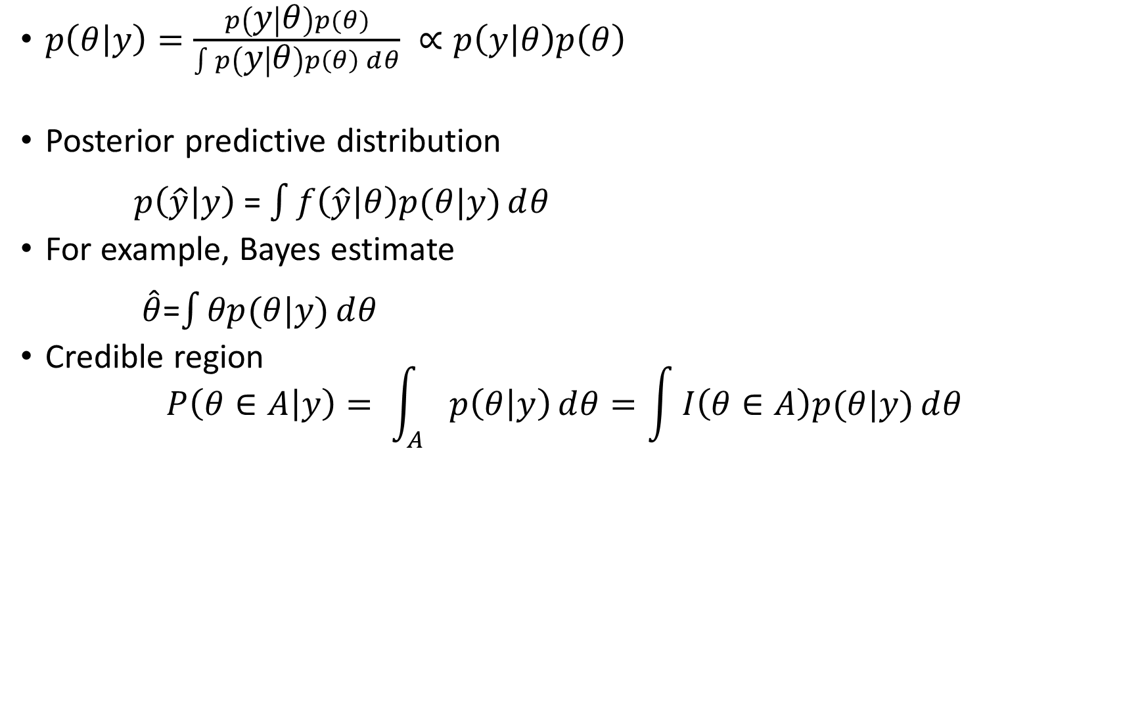
Basic Bayes Concepts
$p\left(θ | y\right)=\frac{p\left(y | θ\right)p(θ)}{\int{p\left(y | θ\right)p\left(θ\right)ⅆθ}} ∝p\left(y | θ\right)p\left(θ\right)$
Posterior predictive distribution $p\left(\hat{y} | y\right)$ = $\int{f\left(\hat{y} | θ\right)p(θ|y)ⅆθ}$
For example, Bayes estimate $\hat{θ}$=$\int{θp(θ|y)}ⅆθ$
Credible region $P\left(θ∈A | y\right)= \int_{A}{p\left(θ | y\right)ⅆθ=\int{I\left(θ∈A\right)p(θ|y)ⅆθ}}$
Notes:
1. This is not the end of the story, we also want to do prediction and inference.
2. This is posterior predictive distribution,. We are actually averaging the predictionsP(y_hat|theta), with weight posterior.
3. When it comes to inference, it’s just a matter of solving integrals. For example, the Bayes estimate is the posterior expectation with a quadratic loss function.
(To minimize expected squared error (L2 loss), E[(θ−θ0)2, To minimize expected absolute error (L1 loss), E[|θ−θ0|]. )
I would also like to have credible interval.
It is basically the same thing as confidence interval in Frequentist world. Just the phosophical difference.
4. Sometimes it’s difficult or impossible to compute the posterior. Then you need good sampling algorithmes to understand the posterior. For example, if you have a die and you don’t understand how it works. Then you roll it and write down what you have. Most of the cases, the posterior are very complicated. That’s impossible to do with pen and paper. But don’t worry, PyStan and PyMC3 will do the inference for you.
=================================================
(In Frequentist world, there is only one true value for the parameter, all estimates are random variables. The upper bound and the lower bound of the confidence interval are not fixed. Confidence interval is also random. In Bayes world, parameters have distributions. Bounds are fixed.)

